Slide 1
Business Process Engineering
Week 06

Slide 2
Selection of Business Partners in Process Choreographies
Consider a business process choreography with multiple business partners, each of which plays a specific role in the choreography.
If there is a role Shipper specified according to the requirements for shipping goods, it can be bound to specific enterprises that can perform the work.

Slide 3
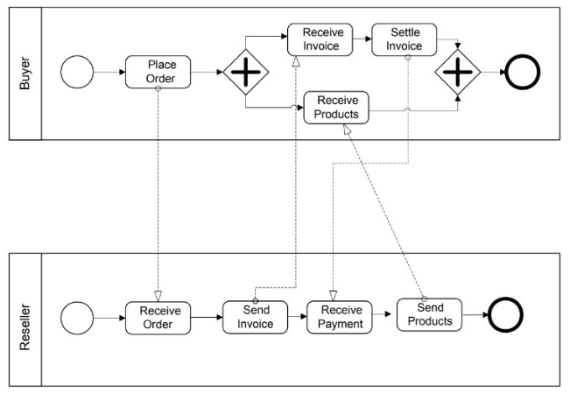
Example of Multiple Business Partners

Slide 4
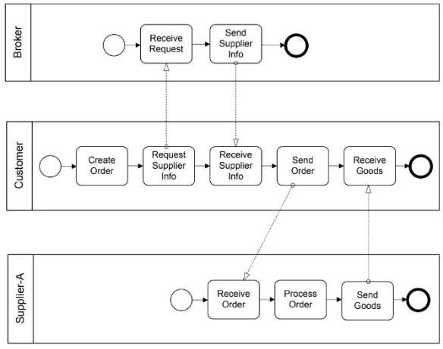
Example of Multiple Business Partners

Slide 5
Public vs. Private Processes
Often multiple agencies (organizations, companies) cooperate, e.g.
♦ Classical purchasing scenarios with customer, retailer and transporter
♦ Partnership where different partners with their resources and know how contribute to a service or product
In this case we can distinguish between public and private processes
♦ Public Process: coordinates work between partners
● describes the inter-organisational cooperation
● internal processes of the partners are treated as "black boxes"
● Specifies the information and objects that are exchanges between partners
♦ Private Process: Process within one organisation
● Detailed process flow for each partner

Slide 6
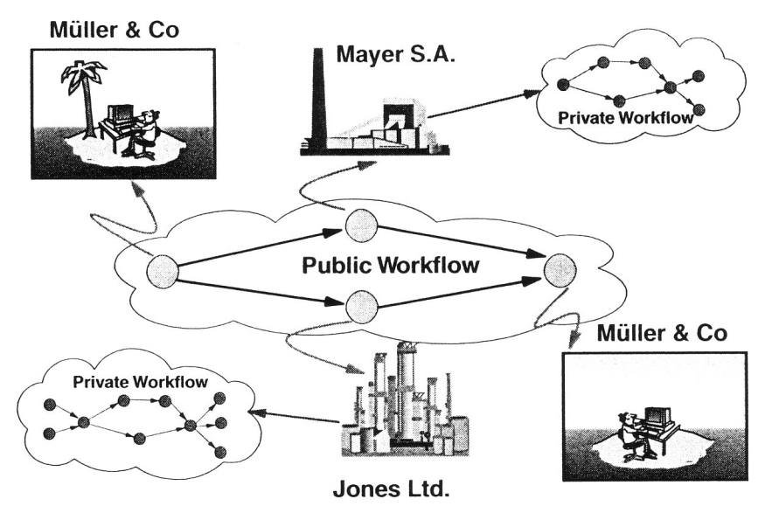
Public and Private Processes

Slide 7
Private and Public Processes in BPMN
BPMN uses Pools when representing the interaction between an organisations and participants outside of its control.
Each participant operates a separate process represented by pools.
Within a company, a single pool covers its own internal operations. It is only when it interacts with external participants that additional pools are required.
Message Flow cannot communicate between Tasks inside a single Pool. This is what Sequence Flow and data flow does.
Message Flow moves the Process from one agency to another.

Slide 8
Orchestration, Choreography, and Collaboration
BPMN supports three main categories of Processes:
♦ Orchestration
♦ Choreography
♦ Collaboration

Slide 9
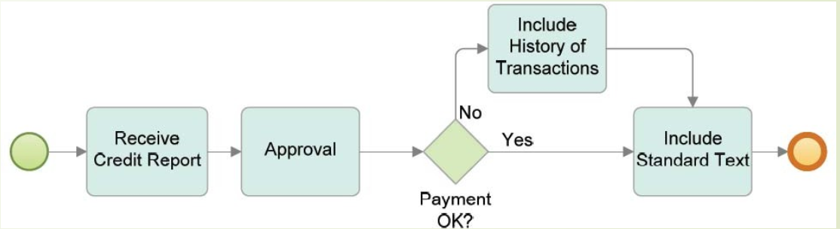
Orchestration
Orchestration models imply a single coordinating point of view.
An orchestration Process describes a process within a single business entity.
An orchestration is contained within a Pool and normally has a well-formed context.
A BPMN diagram may contain more than one orchestration. If so, each orchestration appears within its own container called a Pool.
Thus, orchestrations (i.e., Processes) are always contained within a Pool.

Slide 10
Choreography Vs Collaboration
A choreography process model is a definition of the behavior between interacting participants.
A choreography does not exist within a well-formed context or focus of control.
There is no central mechanism that drives or keeps track of a choreography.
Therefore, there are no shared data available to all the elements of the choreography.
To place choreography within BPMN diagrams is to put them between the Pools.
Collaboration shows the participants and their interactions in BPMN a collaboration only shows Pools and the message flow between them

Slide 11
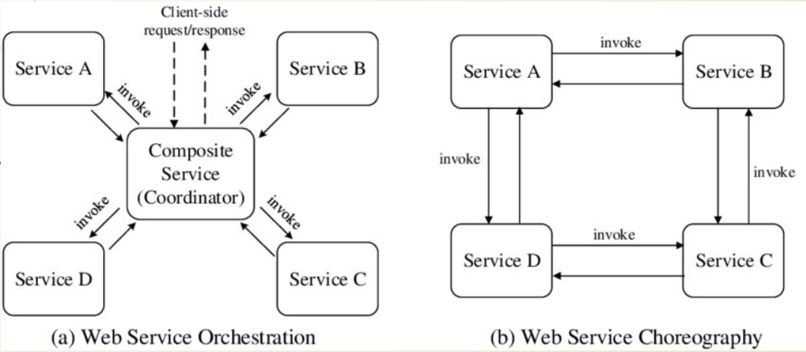
The term Process Conversation refers to the concrete messages that are ex-changed as specified in a given process choreography.
Therefore, process choreographies serve as conversation models.

Slide 12
Process Choreography
Choreographies have a central role in ensuring interoperability between process orchestrations.
It is performed by a participant in a business-to-business collaboration.
Several industry initiatives are in place for establishing standardized choreographies in particular domains.
Examples: include RosettaNet for the supply chain domain, SWIFTNet for financial services, and Health Level Seven (HL7) for health care services.
They all define rules for the collaboration that companies need to comply with in order to collaborate with each other.

Slide 13
Process Choreography
By introducing collaboration rules, costs for the individual companies are reduced.
New companies can join the market more easily, since they know the rules of that domain.
These collaboration rules are specified by process choreographies.

Slide 14
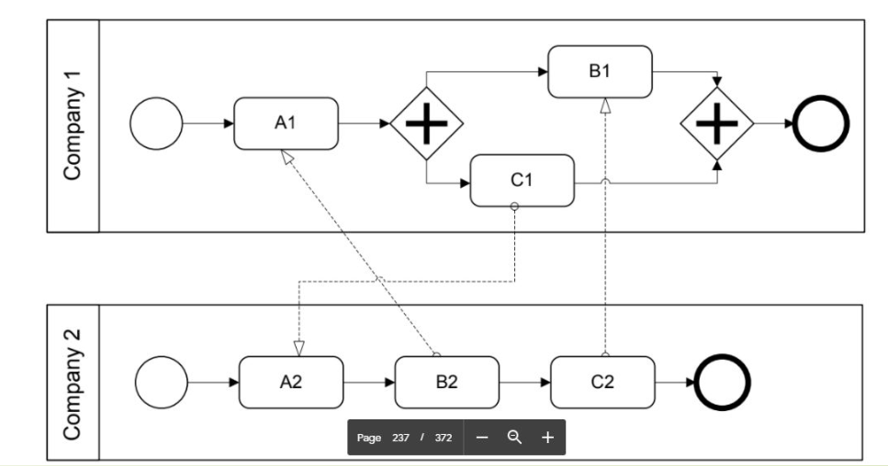
Process Choreography

Slide 15
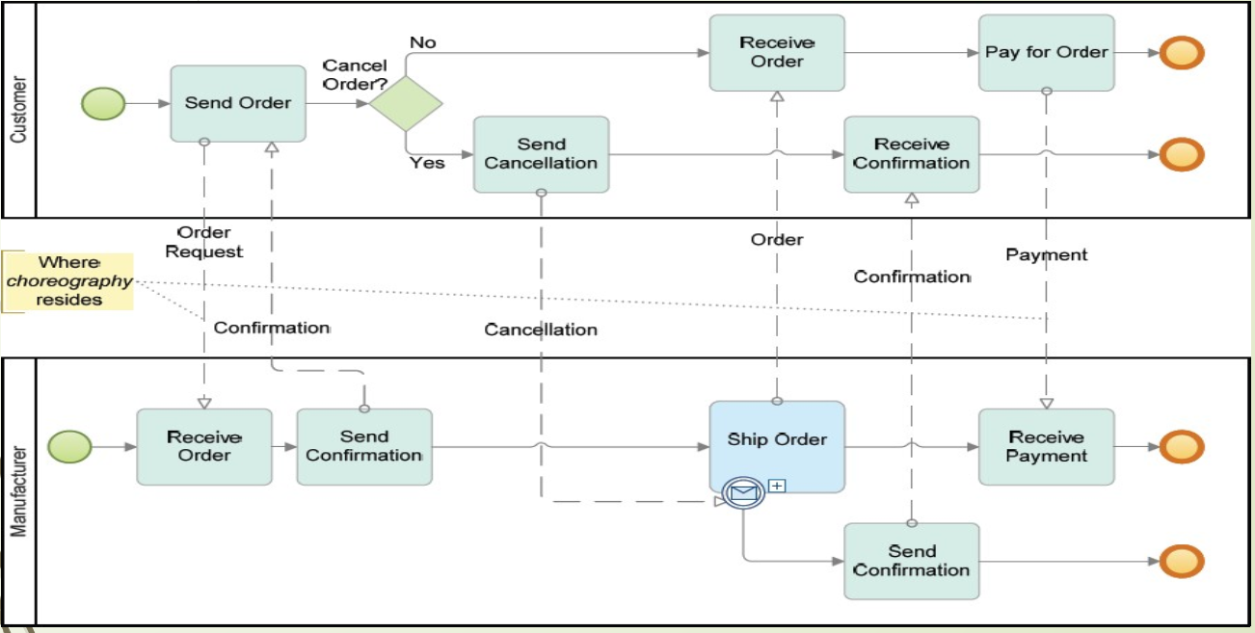
Choreography Example

Slide 16
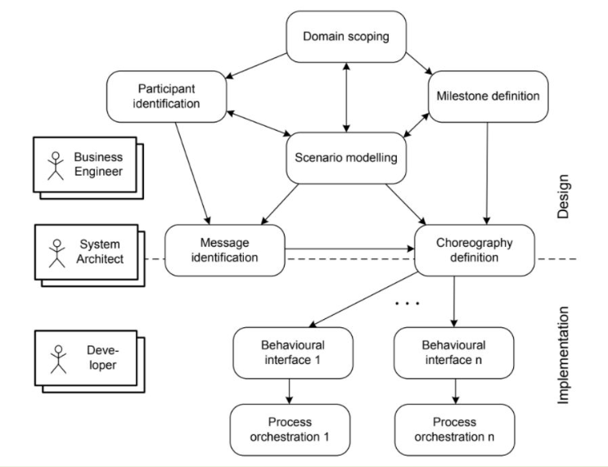
The phases involved in the development of process choreographies
There are three associated roles that
represent the stakeholders involved
in choreography design and
implementation.

Slide 17
Business Engineers
Business engineers are mainly involved in the choreography design phases :
1. Scenario modelling--Plan
2. Domain scoping--what users can and cannot access
3. Milestone definition--Goals
4. Participant identification
Business engineers are responsible for business-related aspects of the process choreography;
They need to make sure that the collaboration contributes to the goals of the enterprise, similarly to organizational business processes.

Slide 18
System Architecture
System architects are responsible for the architectural aspects of the implemented process choreography.
System architects are at the border of design and implementation,

Slide 19
Process Choreography Design
1. High-level Structure Design:
2. High-level Behavioral Design:
3. Collaboration Scenarios:
4. Behavioral Interfaces:

Slide 20
Problem Statement
Auctioning brings together a seller and a buyer. The seller owns a certain good or offers a certain service.
There are a number of potential buyers interested in the same item offered.
The auctioning mechanism determines the actual buyer by allowing bidders (the potential buyers) to place bids.
The auction has a predefined timeframe, e.g. several days.
Only during the auction, the bidders are allowed to place their bids.
The seller might define a minimum bid and there might be a fixed bidding increment depending on the currently highest bid and the policies of the auctioning service.
Once the auction is over, the bidder who has placed the highest bid wins and follow-up activities such as payment and delivery are initiated.

Slide 21
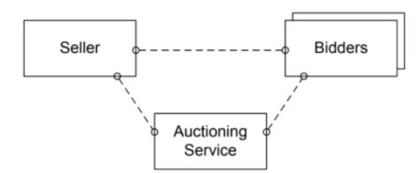
1- High-Level Design-Structural
High-level process choreography design involves structure design and behaviour design.
In high-level structure design, participant roles of the choreography are defined,

Slide 22
2- High-leve design- behaviour
High-level process choreography design involves structure design and behaviour design.
High-level behaviour uses milestones that are achieved during the collaboration;
Each milestone represents a state in the overall collaboration that has a business meaning.

Slide 23
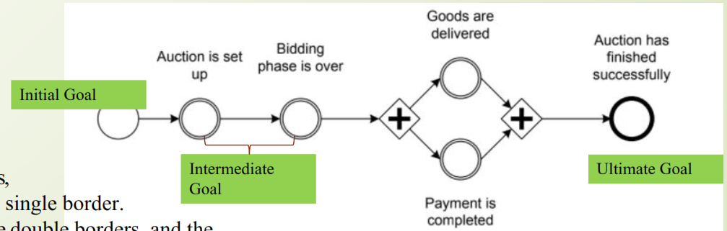

milestones are defined by circles,
Goal where the initial milestone has a single border.
The intermediate milestones have double borders, and
The ultimate goal milestone has a bold border.

Slide 24
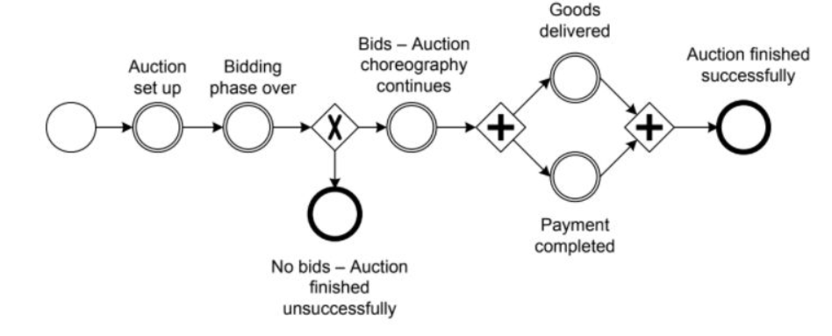
High-level behavioural model for bidding scenario, with different outcomes
if no single bid is placed during the auction. In this case, delivery and payment cannot occur, and the conversation ends without the final goal being reached.

Slide 25
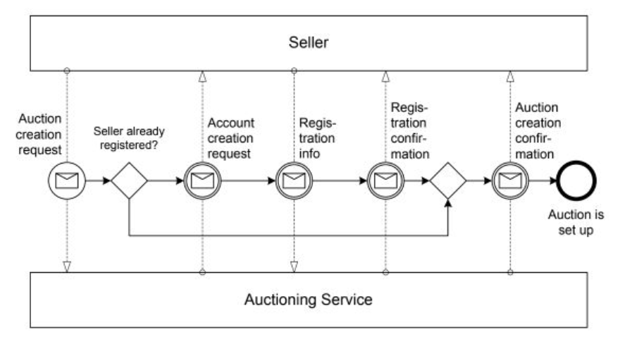
3- Collaboration Scenarios
In this phase, the interactions needed to proceed from one milestone to another are specified.
Interactions between process participants serve as the building blocks for the resulting collaboration scenarios.

Slide 26
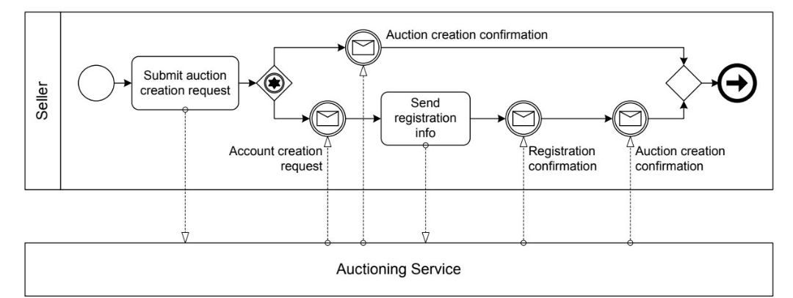
4- Behavioral interface for seller
A behavioural interface covers the individual view of one specific participant in the process choreography;
Behavioral interfaces consider parts of process orchestrations
Behavioral interfaces consider parts of process orchestrations

Slide 27
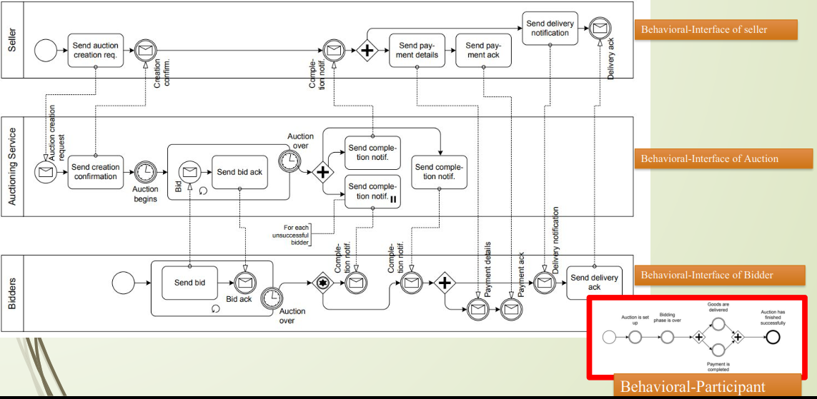
Summary- model for bidding scenario

Slide 28
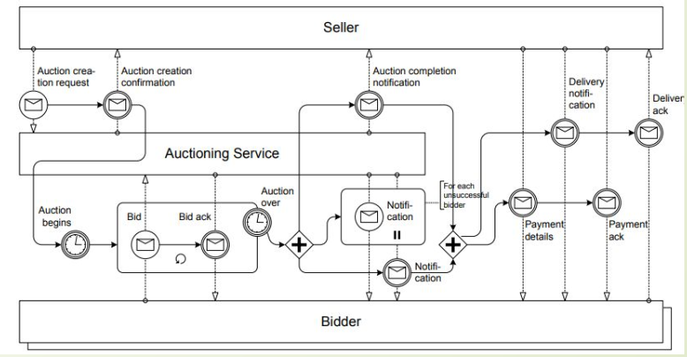
Interaction Model/collabration

Slide 29
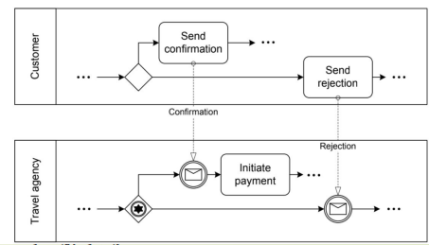
Racing Incoming Messages
Racing incoming messages are common in business-to-business scenarios; this pattern is described as follows: a participant is waiting for a message to arrive, but other participants have the chance to send a message.
These messages by different participants “race” with each other. Only the first message arriving will be processed.
A scenario where a travel agent has reserved a flight for a customer, and now waits for a confirmation or a notification that the flight details are not acceptable.
In the case of confirmation the payment is initiated, and in the case of rejection a new flight reservation might be needed.

Slide 30

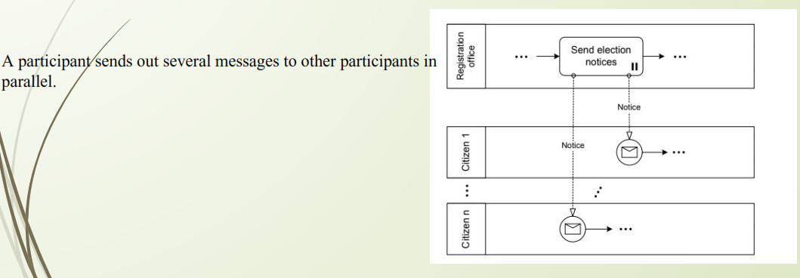

Slide 31
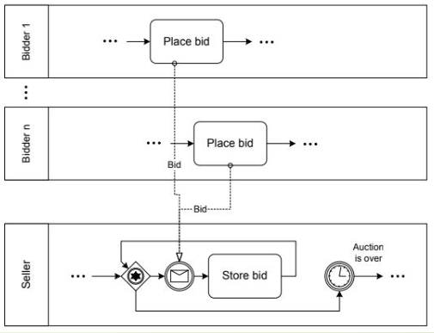
One-From-Many Receive
In the one-from-many receive pattern, messages can be received from many participants.

Slide 32
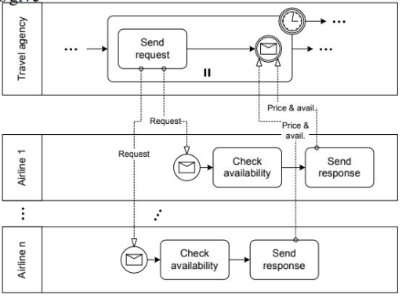
One-To-Many Send/Receive
A travel agency looks for the best offer for a flight on a certain route.
The agent therefore initiates requests and the airlines give their prices and current availability,

Slide 33
Contingent requests patter
A participant sends a request to another participant.
If this participant does not answer within a given time, the request is sent to a second participant.
Again, if no response comes back, a third participant is contacted, and so on. Delayed responses, i.e., responses arriving after the time-out has already occurred, might or might not be discarded.

